Slide 1

FDP on Data Science
Dr. V. Vijayalakshmi
DSBS
SRMIST
 | 1

Slide 2
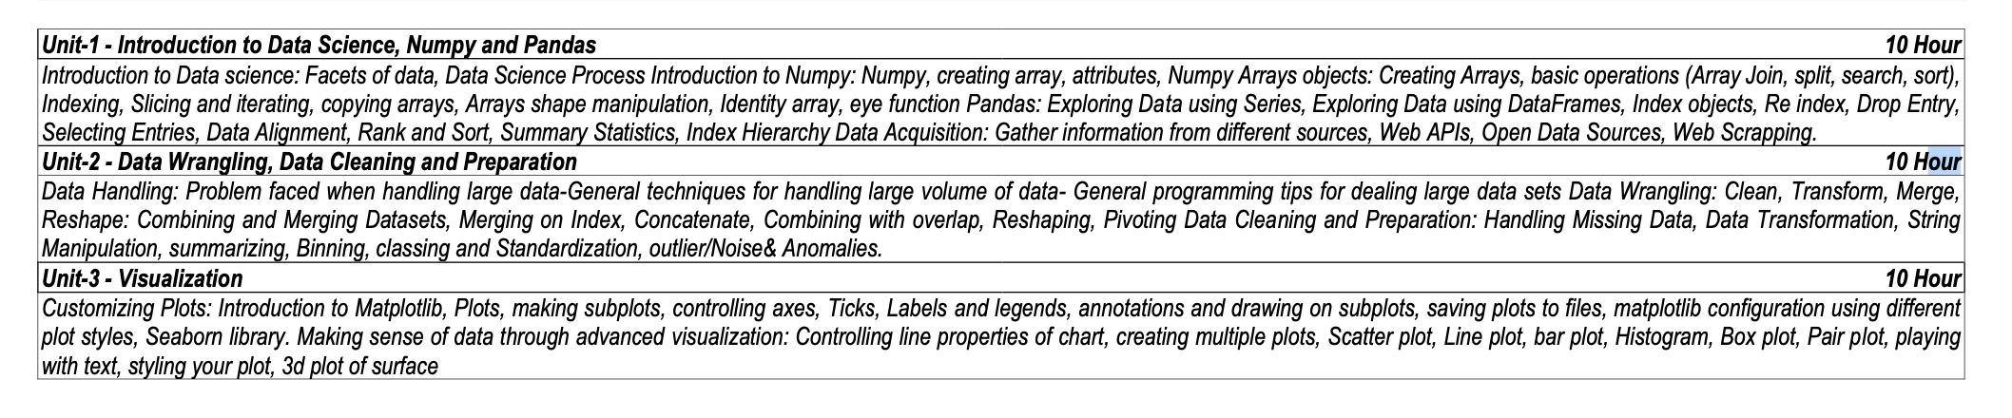
Data Science to All
 | 2

Slide 3
Introduction to Data Science
 | 3

Slide 4
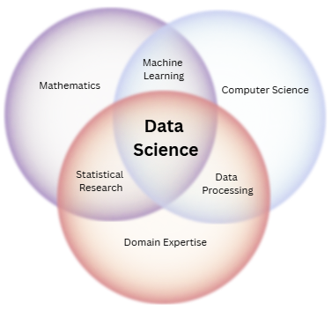
Introduction to Data Science
Data science is a multidisciplinary field that uses statistical and computational methods to extract insights and knowledge from data.
It involves a combination of skills and knowledge from various fields such as statistics, computer science, mathematics, and domain expertise.
 | 4

Slide 5
Introduction to Data Science
Data Science involves obtaining meaningful information or insights from structured or unstructured data through a process of analyzing, programming, and business skills.
Data scientists use a variety of tools and methods, such as machine learning, statistical modeling, and data visualization, to analyze and make predictions from data.
They work with both structured and unstructured data, and use the insights gained to inform decision making and support business operations.
 | 5

Slide 6
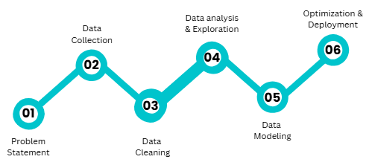
How Data Science works?
Data science is not a one-step process such that you will get to learn it in a short time.
Every step has its value and it counts in your model.
 | 6

Slide 7

How Data Science works?
Problem Statement: It’s really important to declare or formulate your problem statement very clearly and precisely. Many scientist considers this as the main and much important step of Date Science.
Data Collection: After defining the problem statement, the next obvious step is to go in search of data that you might require for your model. Data can be in any form i.e unstructured or structured. It might be in various forms like videos, spreadsheets, coded forms, etc. You must collect all these kinds of sources.
 | 7

Slide 8

How Data Science works?
Data Cleaning: The next step to do is cleaning. Data cleaning is the most favorite thing for data scientists to do. It is all about the removal of missing, redundant, unnecessary and duplicate data from your collection.
Data Analysis and Exploration: It’s about analyzing the structure of data, finding hidden patterns in them, studying behaviors, visualizing the effects of one variable over others and then concluding. We can explore the data with the help of various graphs formed with the help of libraries using any programming language.
 | 8

Slide 9
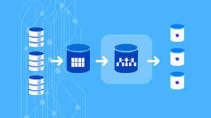
How Data Science works?
Data Modelling: Once you are done with your study that you have formed from data visualization, you must start building a hypothesis model such that it may yield you a good prediction in future. There different kinds of algorithms from regression, classification, Clustering, etc.
Optimization and Deployment: You test your data and find how well it is performing by checking its accuracy. In short, you check the efficiency of the data model and thus try to optimize it for better accurate prediction. Deployment deals with the launch of your model and let the people outside there to benefit from that.
 | 9

Slide 10
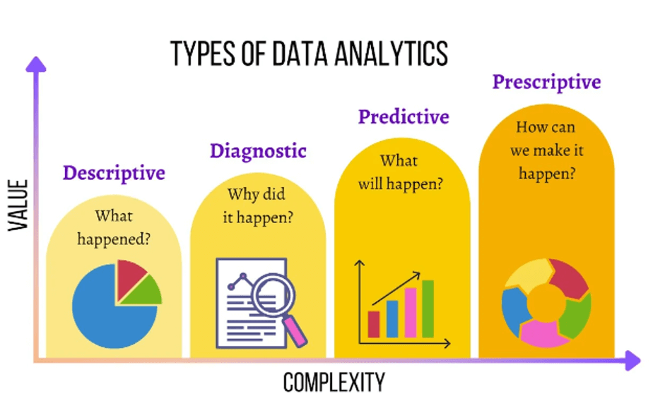
Types of Analysis
Descriptive Analysis: Summarizes historical data to understand past performance.
Diagnostic Analysis: Identifies causes and reasons behind specific events or trends.
Predictive Analysis: Uses historical data to forecast future events or trends.
Prescriptive Analysis: Recommends actions to achieve desired outcomes based on analysis.
 | 10

Slide 11
Types of Analysis
Descriptive analysis examines data to gain insights into what happened or what is happening in the data environment.
It is characterized by data visualizations such as pie charts, bar charts, line graphs, tables, or generated narratives.
For example, a flight booking service may record data like the number of tickets booked each day.
 | 11

Slide 12
Types of Analysis
Diagnostic analysis is a deep-dive or detailed data examination to understand why something happened.
Multiple data operations and transformations may be performed on a given data set to discover unique patterns in each of these techniques.
For example, the flight service might drill down on a particularly high-performing month to better understand the booking spike.
 | 12

Slide 13
Types of Analysis
Predictive analysis uses historical data to make accurate forecasts about data patterns that may occur in the future.
It is characterized by techniques such as machine learning, forecasting, pattern matching, and predictive modeling.
In each of these techniques, computers are trained to reverse engineer causality connections in the data.
For example, to predict flight booking patterns for the coming year at the start of each year.
 | 13

Slide 14
Types of Analysis
Prescriptive analytics takes predictive data to the next level.
It not only predicts what is likely to happen but also suggests an optimum response to that outcome.
It can analyze the potential implications of different choices and recommend the best course of action.
It uses graph analysis, simulation, complex event processing, neural networks, and recommendation engines from machine learning.
 | 14

Slide 15

Applications of Data Science
Healthcare
Finance
Marketing
Retail
Transportation
Education
Entertainment
Manufacturing
Energy
Government
 | 15

Slide 16
Facets of Data
 | 16

Slide 17

Facets of Data
Very large amount of data will generate in big data and data science.
These data is various types and main categories of data are as follows:
Structured
Unstructured
Natural language
Machine-generated
Audio, video and images
Graph-based
Streaming
 | 17

Slide 18
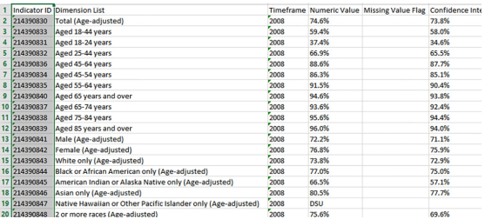
Structured Data
Structured data is arranged in rows and column format. It helps for application to retrieve and process data easily. Database management system is used for storing structured data.
The term structured data refers to data that is identifiable because it is organized in a structure. Structured data is also searchable by data type within content. Structured data is understood by computers and is also efficiently organized for human readers.
An Excel table is an example of structured data.
 | 18

Slide 19
Unstructured Data
Unstructured data is data that does not follow a specified format. Row and columns are not used for unstructured data. Therefore it is difficult to retrieve required information.
Unstructured data has no identifiable structure.
The unstructured data can be in the form of Text: (Documents, email messages, customer feedbacks), audio, video, images. Email is an example of unstructured data.
Even today in most of the organizations more than 80% of the data are in unstructured form. This carries lots of information. But extracting information from these various sources is a very big challenge.
 | 19

Slide 20

Characteristics of Unstructured Data
There is no structural restriction or binding for the data.
Data can be of any type.
Unstructured data does not follow any structural rules.
There are no predefined formats, restriction or sequence for unstructured data.
Since there is no structural binding for unstructured data, it is unpredictable in nature.
 | 20

Slide 21

Natural Language
Natural language is a special type of unstructured data.
Natural language processing enables machines to recognize characters, words and sentences, then apply meaning and understanding to that information. This helps machines to understand language as humans do.
The natural language processing community has had success in entity recognition, topic recognition, summarization, text completion and sentiment analysis.
For natural language processing to help machines understand human language, it must go through speech recognition, natural language understanding and machine translation.
It is an iterative process comprised of several layers of text analysis.
 | 21

Slide 22
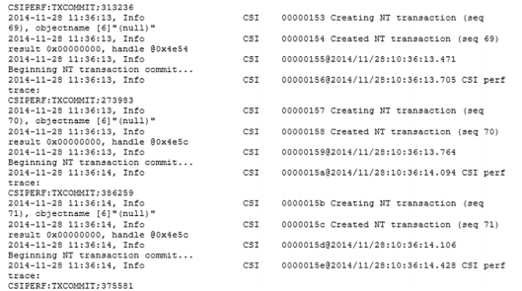
Machine Generated Data
Machine-generated data is an information that is created without human interaction as a result of a computer process or application activity.
This means that data entered manually by an end-user is not recognized to be machine-generated.
Machine data contains a definitive record of all activity and behavior of our customers, users, transactions, applications, servers, networks, factory machinery and so on.
Examples of machine data are web server logs, call detail records, sensor data, network event logs and telemetry.
 | 22

Slide 23
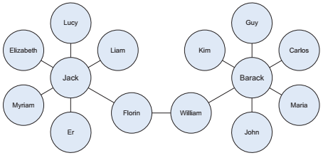
Graph-based data
A graph contains a collection of entities called nodes and another collection of interactions between a pair of nodes called edges. Nodes represent entities, which can be of any object type that is relevant to our problem domain.
A graph database stores nodes and relationships instead of tables or documents.
Examples of graph-based data can be found on many social media websites.
For instance, on LinkedIn you can see who you know at which company. Your follower list on Twitter is another example of graph-based data.
 | 23

Slide 24

Audio, video and images
Audio, image, and video are data types that pose specific challenges to a data scientist. Tasks that are trivial for humans, such as recognizing objects in pictures, turn out to be challenging for computers.
MLBAM (Major League Baseball Advanced Media) announced in 2014 that they’ll increase video capture to approximately 7 TB per game for the purpose of live, in-game analytics.
High-speed cameras at stadiums will capture ball and athlete movements to calculate in real time, for example, the path taken by a defender relative to two baselines.
 | 24

Slide 25
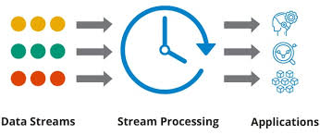
Streaming Data
Streaming data is data that is generated continuously by thousands of data sources, which typically send in the data records simultaneously and in small sizes (order of Kilobytes).
Streaming data includes a wide variety of data such as log files generated by customers using your mobile or web applications, ecommerce purchases, in-game player activity, information from social networks, financial trading floors or geospatial services and telemetry from connected devices or instrumentation in data centers.
Examples are the “What’s trending” on Twitter, live sporting or music events, and the stock market.
 | 25

Slide 26
Data Science Process
 | 26

Slide 27
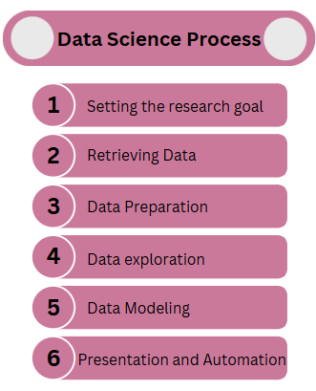
Data Science Process
The data science process typically consists of six steps.
 | 27

Slide 28

1. Setting the research goal
The first step of this process is setting a research goal.
Data science is mostly applied in the context of an organization. When the business asks you to perform a data science project, you’ll first prepare a project charter.
This charter contains information such as what you’re going to research, how the company benefits from that, what data and resources you need, a timetable, and deliverables.
 | 28

Slide 29

2. Retrieving data
The second step is to Data Retrieval. You’ve stated in the project charter which data you need and where you can find it.
In this step you ensure that you can use the data in your program, which means checking the existence of, quality, and access to the data.
Data can also be delivered by third-party companies and takes many forms ranging from Excel spreadsheets to different types of databases.
 | 29

Slide 30

3. Data Preparation
Data Preparation is an error-prone process; in this phase you enhance the quality of the data and prepare it for use in subsequent steps.
This phase consists of three subphases:
Data Cleansing removes false values from a data source and inconsistencies across data sources.
Data Integration enriches data sources by combining information from multiple data sources.
Data Transformation ensures that the data is in a suitable format for use in your models.
 | 30

Slide 31

4. Data Exploration
Data Exploration is concerned with building a deeper understanding of your data.
You try to understand how variables interact with each other, the distribution of the data, and whether there are outliers.
To achieve this you mainly use descriptive statistics, visual techniques, and simple modeling.
This step often goes by the abbreviation EDA, for Exploratory Data Analysis.
 | 31

Slide 32
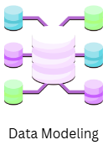
5. Data Modeling
In this phase you use models, domain knowledge, and insights about the data you found in the previous steps to answer the research question.
You select a technique from the fields of statistics, machine learning, operations research, and so on.
Building a model is an iterative process that involves selecting the variables for the model, executing the model, and model diagnostics.
 | 32

Slide 33

6. Presentation and Automation
Finally, you present the results to your business. These results can take many forms, ranging from presentations to research reports.
Sometimes you’ll need to automate the execution of the process because the business will want to use the insights you gained in another project or enable an operational process to use the outcome from your model.
 | 33

Slide 34
Introduction to NumPy
 | 34

Slide 35
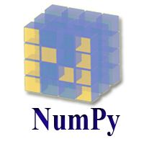
Introduction to NumPy
NumPy stands for Numeric Python which is a python package for the computation and processing of the multidimensional and single dimensional array elements.
Travis Oliphant created NumPy package in 2005 by injecting the features of the ancestor module Numeric into another module Numarray.
It is an open source project and you can use it freely.
It also has functions for working in domain of linear algebra, fourier transform, and matrices.
 | 35

Slide 36

Introduction to NumPy
In Python we have lists that serve the purpose of arrays, but they are slow to process.
NumPy aims to provide an array object that is up to 50x faster than traditional Python lists.
The array object in NumPy is called ndarray, it provides a lot of supporting functions that make working with ndarray very easy.
Arrays are very frequently used in data science, where speed and resources are very important.
 | 36

Slide 37
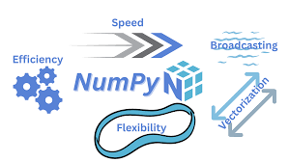
Introduction to NumPy
Why NumPy faster than List?
NumPy arrays are stored at one continuous place in memory unlike lists, so processes can access and manipulate them very efficiently.
This behavior is called locality of reference in computer science.
This is the main reason why NumPy is faster than lists.
It is optimized to work with latest CPU architectures.
 | 37

Slide 38
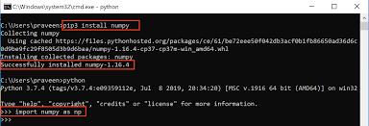
Installation of NumPy
Installation
If you have Python and PIP already installed on a system, then installation of NumPy is very easy.
Install it using this command: pip install numpy
Import
Once NumPy is installed, import it in your applications by adding the import keyword: import numpy as np
NumPy is usually imported under the np alias.
 | 38

Slide 39
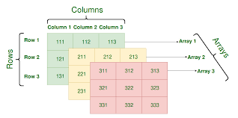
Advantages of NumPy
NumPy performs array-oriented computing.
It efficiently implements the multidimensional arrays.
It performs scientific computations.
It is capable of performing Fourier Transform and reshaping the data stored in multidimensional arrays.
NumPy provides the in-built functions for linear algebra and random number generation.
 | 39

Slide 40

Applications of NumPy
NumPy is an important library generally used for:
Machine Learning
Data Science
Image and Signal Processing
Scientific Computing
Quantum Computing
 | 40

Slide 41
Creating Array, Attributes, Array Objects
 | 41

Slide 42
Creating Array
NumPy array is a powerful N-dimensional array object and is used in linear algebra, Fourier transform, and random number capabilities.
NumPy is used to work with arrays. The array object in NumPy is called ndarray.
We can create a NumPy ndarray object by using the array() function.
Array Object:
Ndarray is the n-dimensional array object defined in the numpy which stores the collection of the similar type of elements. In other words, we can define a ndarray as the collection of the data type (dtype) objects.
The ndarray object can be accessed by using the 0 based indexing.
Each element of the Array object contains the same size in the memory.
 | 42

Slide 43
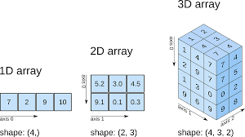
Creating Array
Dimensions:
0-D Arrays
1-D Arrays
2-D Arrays
3-D arrays
 | 43

Slide 44
Creating Array
0-D Arrays
import numpy as np arr = np.array(42) print(arr)
2-D Arrays
import numpy as np arr = np.array([[1, 2, 3], [4, 5, 6]]) print(arr)
1-D Arrays
import numpy as np arr = np.array([1, 2, 3, 4, 5]) print(arr)
3-D Arrays
import numpy as np arr = np.array([[[1,2,3],[4,5,6]],[[1,2,3],[4,5,6]]]) print(arr)
 | 44

Slide 45
Array Attributes
In NumPy, attributes are properties of NumPy arrays that provide information about the array's shape, size, data type, dimension, and so on.
ndim | - returns number of dimension of the array
size | - returns number of elements in the array
dtype | - returns data type of elements in the array
shape | - returns the size of the array in each dimension.
itemsize | - returns the size (in bytes) of each elements in the array
 | 45

Slide 46
Array Attributes
ndim
import numpy as np
arr = np.array([[2, 4, 6],[1, 3, 5]])
print(arr.ndim)
Output: 2
size
import numpy as np
arr = np.array([[2, 4, 6],[1, 3, 5]])
print(arr.size)
Output: 6
 | 46

Slide 47
Array Attributes
shape
import numpy as np
arr = np.array([[2, 4, 6],[1, 3, 5]])
print(arr.shape)
Output: (2,3) #2 rows and 3 columns
dtype
import numpy as np
arr = np.array([6, 7, 8])
print(arr.dtype)
Output: int64
 | 47

Slide 48
Array Attributes
itemsize
import numpy as np
arr1 = np.array([6, 7, 8, 10, 13])
arr2 = np.array([6, 7, 8, 10, 13], dtype=np.int32)
print(arr1.itemsize) # prints 8
print(arr2.itemsize) # prints 4
arr1 is an array containing 64-bit integers by default, which uses 8 bytes of memory per element.
So, itemsize returns 8 as the size of each element.
arr2 is an array of 32-bit integers, so each element in this array uses only 4 bytes of memory.
So, itemsize returns 4 as the size of each element.
 | 48

Slide 49
Array Basics Operations
 | 49

Slide 50
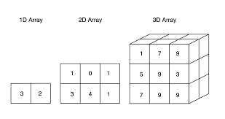
Array Basics Operations
There are different types of array operations:
Arithmetic Operations
Comparison Operations
Logical Operations
 | 50

Slide 51
Arithmetic Operations
Element-wise Operation | Operator | Function
Addition | + | add()
Subtraction | - | subtract()
Multiplication | * | multiply()
Division | / | divide()
Exponentiation | ** | power()
Modulus | % | mod()
 | 51

Slide 52
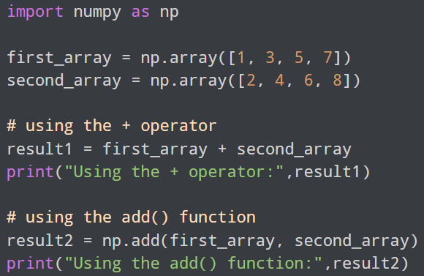
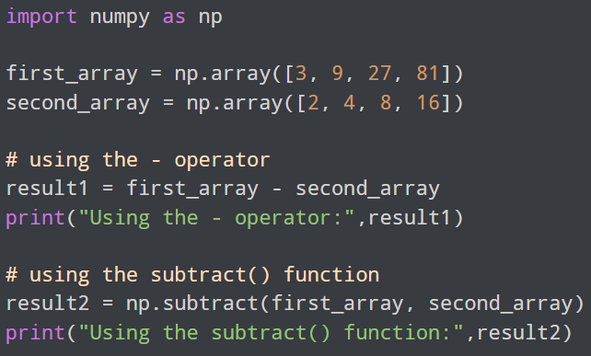


Arithmetic Operations
Addition
Subtraction
 | 52

Slide 53
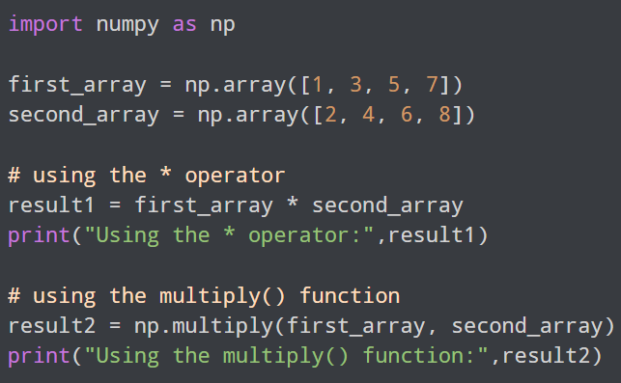
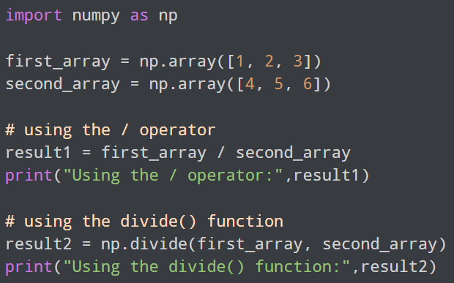


Arithmetic Operations
Multiplication
Division
 | 53

Slide 54
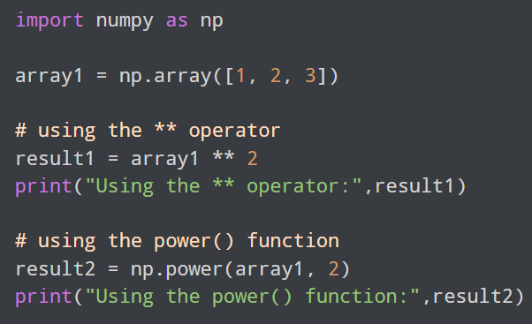
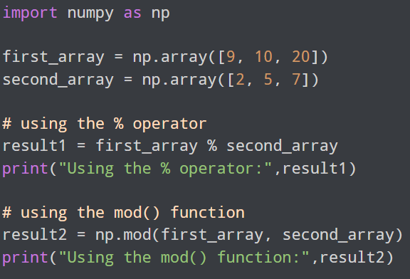


Arithmetic Operations
Exponential
Modulus
 | 54

Slide 55
Comparison Operations
Operators | Descriptions
< (less than) | returns True if element of the first array is less than the second one
<= (less than or equal to) | returns True if element of the first array is less than or equal to the second one
> (greater than) | returns True if element of the first array is greater than the second one
>= (greater than or equal to) | returns True if element of the first array is greater than or equal to the second one
== (equal to) | returns True if the element of the first array is equal to the second one
!= (not equal to) | returns True if the element of the first array is not equal to the second one
 | 55

Slide 56
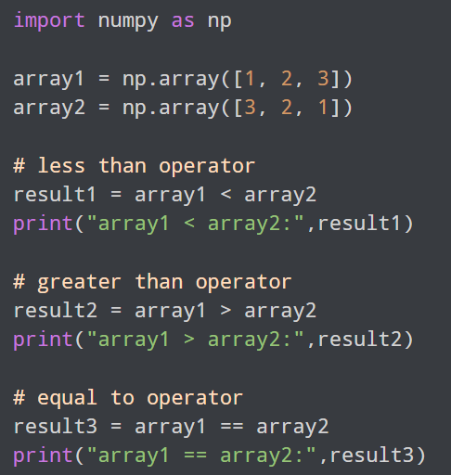
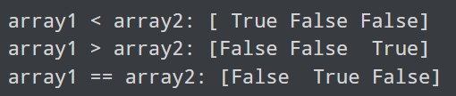
Comparison Operations
 | 56

Slide 57
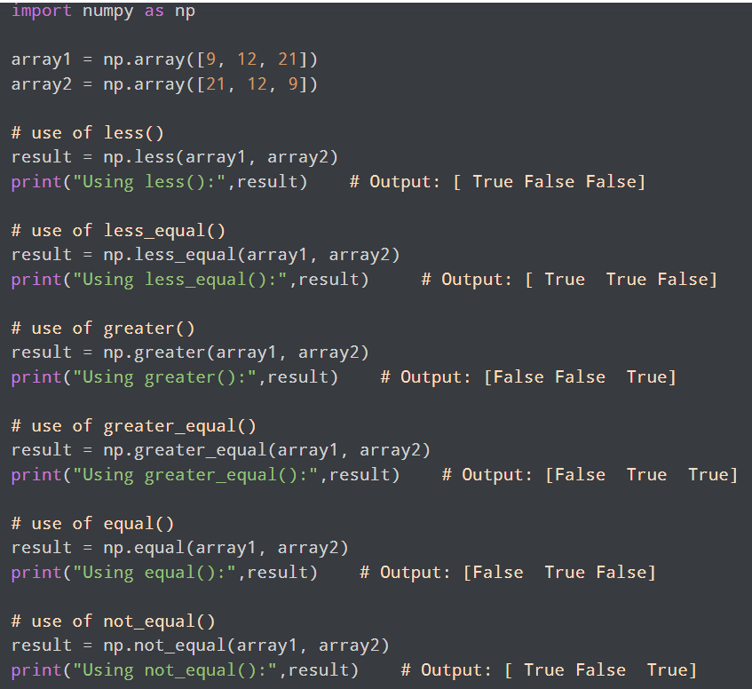
Comparison Operations
 | 57

Slide 58
Logical Operations
Operators | Descriptions
logical_and | Computes the element-wise truth value of x1 AND x2
logical_or | Computes the element-wise truth value of x1 OR x2
logical_not | Computes the element-wise truth value of NOT x
 | 58

Slide 59
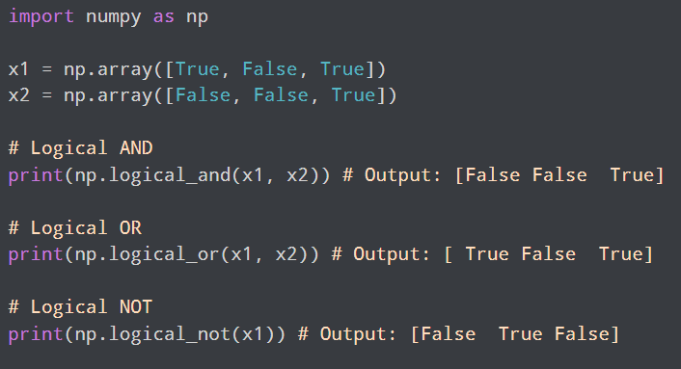
Logical Operations
 | 59

Slide 60
Indexing, Slicing and Iterating
 | 60

Slide 61
Array Indexing
NumPy indexing is used for accessing an element from an array by giving it an index value that starts from 0.
 | 61

Slide 62

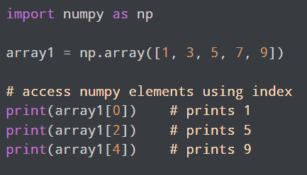
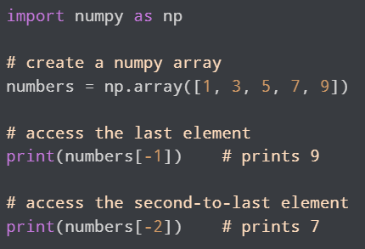
One Dimensional Array Indexing
 | 62

Slide 63
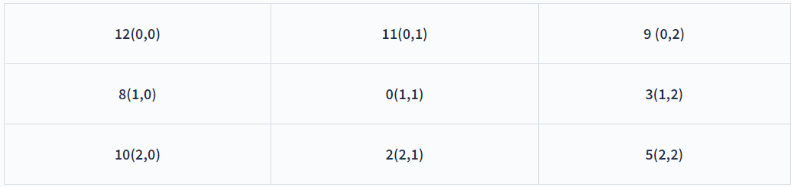
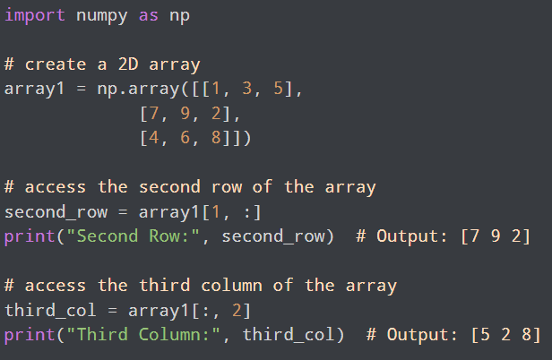
Two Dimensional Array Indexing
 | 63

Slide 64
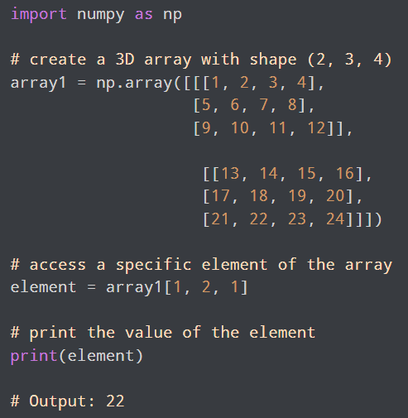
Three Dimensional Array Indexing
To access an element of a 3D array, we use three indices separated by commas.
The first index refers to the slice
The second index refers to the row
The third index refers to the column.
 | 64

Slide 65
Array Slicing
Array Slicing is the process of extracting a portion of an array.
1D Array Slicing
array[start:stop:step]
start - index of the first element to be included in the slice
stop - index of the last element (exclusive)
step - step size between each element in the slice
 | 65

Slide 66
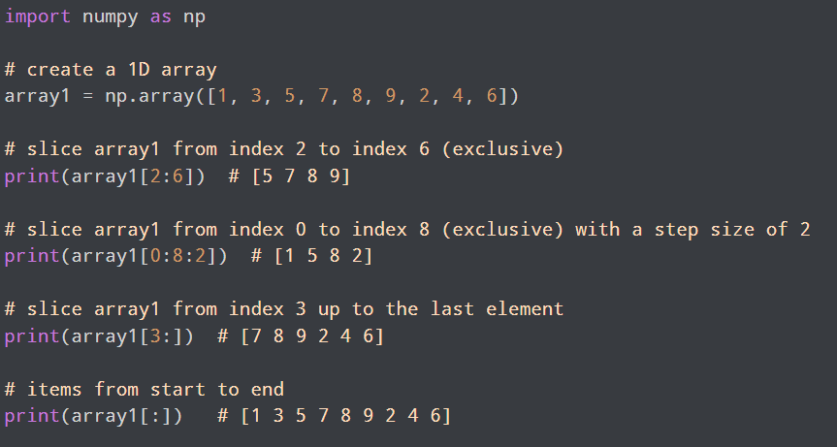
One Dimensional Array Slicing
 | 66

Slide 67
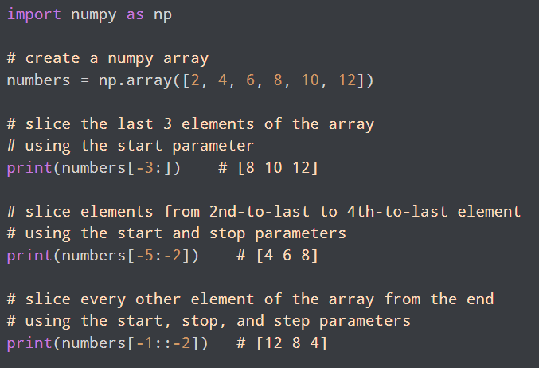
One Dimensional Array Slicing
 | 67

Slide 68
Two Dimensional Array Slicing
array[row_start:row_stop:row_step, col_start:col_stop:col_step]
row_start,row_stop,row_step - specifies starting index, stopping index, and step size for the rows respectively
col_start,col_stop,col_step - specifies starting index, stopping index, and step size for the columns respectively
 | 68

Slide 69
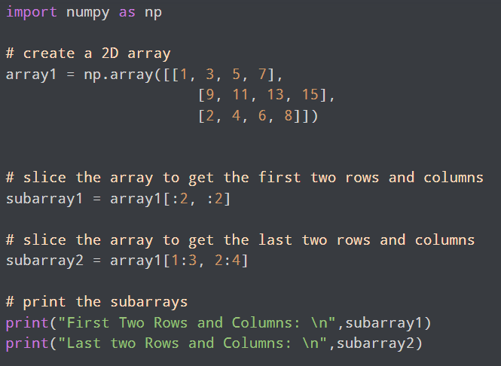
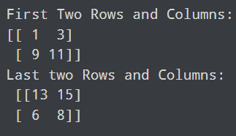
Two Dimensional Array Slicing
 | 69

Slide 70
Iterating Array
Iterating means going through elements one by one.
As we deal with multi-dimensional arrays in NumPy, we can do this using basic for loop of python.
Iterating 1D Array:
import numpy as np arr = np.array([1, 2, 3]) for x in arr: print(x)
Output:
1
2
3
 | 70

Slide 71
Iterating Array
Iterating 2D Array:
import numpy as np arr = np.array([[1, 2, 3], [4, 5, 6]]) for x in arr: print(x)
Output:
[1 2 3]
[4 5 6]
 | 71

Slide 72
Iterating Array
Iterating 3D Array:
import numpy as np arr = np.array([[[1, 2, 3], [4, 5, 6]], [[7, 8, 9], [10, 11, 12]]]) for x in arr: print(x)
Output:
[[1 2 3]
[4 5 6]]
[[ 7 8 9]
[10 11 12]]
 | 72

Slide 73
Copying Arrays, Arrays shape Manipulation,
Identity Array, eye function
 | 73

Slide 74
Copying Arrays
The copy owns the data and any changes made to the copy will not affect original array, and any changes made to the original array will not affect the copy.
import numpy as np arr = np.array([1, 2, 3, 4, 5]) x = arr.copy() arr[0] = 42 print(arr) print(x)
Output:
[42 2 3 4 5]
[1 2 3 4 5]
 | 74

Slide 75
Arrays shape Manipulation
Reshaping means changing the shape of an array.
The shape of an array is the number of elements in each dimension.
By reshaping we can add or remove dimensions or change number of elements in each dimension.
Reshape From 1-D to 2-D
import numpy as np arr = np.array([1, 2, 3, 4, 5, 6, 7, 8, 9, 10, 11, 12]) newarr = arr.reshape(4, 3) print(newarr)
Output:
[[ 1 2 3]
[ 4 5 6]
[ 7 8 9]
[10 11 12]]
 | 75

Slide 76
Arrays shape Manipulation
Reshape From 1-D to 3-D
import numpy as np arr = np.array([1, 2, 3, 4, 5, 6, 7, 8, 9, 10, 11, 12]) newarr = arr.reshape(2, 3, 2) print(newarr)
Output:
[[[ 1 2]
[ 3 4]
[ 5 6]]
[[ 7 8]
[ 9 10]
[11 12]]]
 | 76

Slide 77
Arrays shape Manipulation
Flattening the arrays: converting a multidimensional array into a 1D array.
We can use reshape(-1) to do this.
import numpy as np arr = np.array([[1, 2, 3], [4, 5, 6]]) newarr = arr.reshape(-1) print(newarr)
Output:
[1 2 3 4 5 6]
 | 77

Slide 78
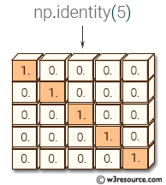
Identity Array
An identity matrix is a square matrix in which all the elements of the main diagonal are equal to 1 and all other elements are equal to 0.
Syntax: numpy.identity(n, dtype=None)
n-Number of rows (and columns) in n x n output.
Dtype-Data-type of the output. Defaults to float.
import numpy as np
np.identity(3, dtype=int)
Output:
array([[1, 0, 0],
[0, 1, 0],
[0, 0, 1]])
import numpy as np
np.identity(2)
Output:
array([[ 1., 0.],
[ 0., 1.]])
 | 78

Slide 79
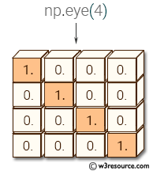
eye Function
The eye() function is used to create a 2-D array with ones on the diagonal and zeros elsewhere.
Syntax: numpy.eye(n, m=None, k=0, dtype=<class 'float'>, order='C’)
n-Number of rows in the output.
m-Number of columns in the output. If None, it defaults to N.
k-ndex of the diagonal. 0 (default) refers to the main diagonal, a positive value refers to an upper diagonal, and a negative value refers to a lower diagonal.
dtype-Data type of the returned array.
order-Memory layout order of the output array. 'C' for row-major and 'F' for column-major.
 | 79

Slide 80
eye Function
import numpy as
np np.eye(2)
Output:
array([[ 1., 0.],
[ 0., 1.]])
np.eye(3, 3)
Output:
array([[ 1., 0., 0.],
[ 0., 1., 0.],
[ 0., 0., 1.]])
import numpy as np
np.eye(2, dtype=int)
Output:
array([[1, 0],
[0, 1]])
np.eye(2,2, dtype=int)
Output:
array([[1, 0],
[0, 1]])
import numpy as np
nums = np.eye(5, k=1, dtype=int)
print(nums)
Output:
[[0 1 0 0 0]
[0 0 1 0 0]
[0 0 0 1 0]
[0 0 0 0 1]
[0 0 0 0 0]]
 | 80

Slide 81
Thank You
 | 81

